Slide 1

CITY OF OPA-LOCKA
Annexation Proposals
Areas “A” and “B”
July, 2013
PREPARED BY THE DEPARTMENT OF COMMUNITY DEVELOPMENT AND PLANNING

Slide 2
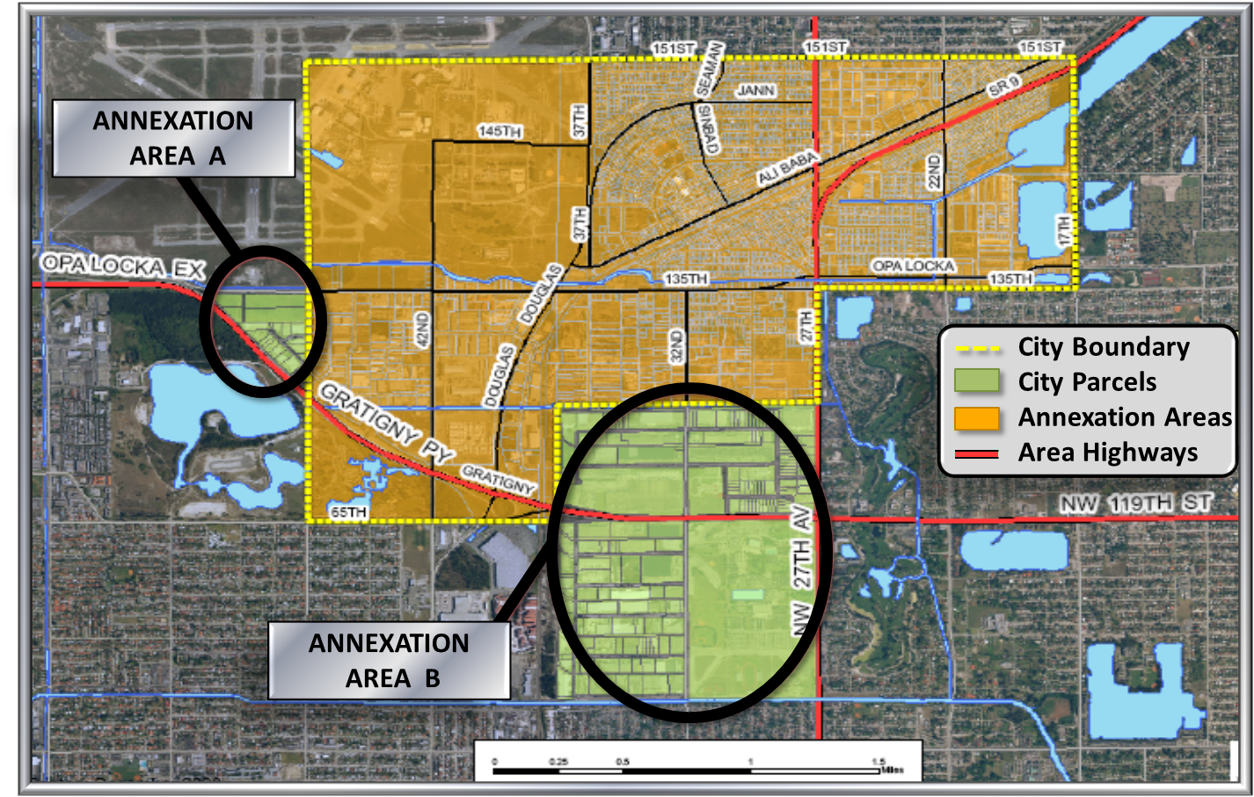
AREAS OF ANNEXATION
Notes:
Overall view of the City boundaries and the proposed areas for annexation. Both areas were selected at the same time as opposed to Part A then Part B to avoid the appearance of “cherry picking” or selecting the best/ most profitable areas for the city while leaving the county with scattered remains.
The City of Opa Locka is interested in the annexation of two areas:
Part A - covering NW 135th St to Gratigny and NW 47th Ave
Part B - covering NW 127th St to NW 107th St and NW37th to NW 27th Ave (Map 1)

Slide 3
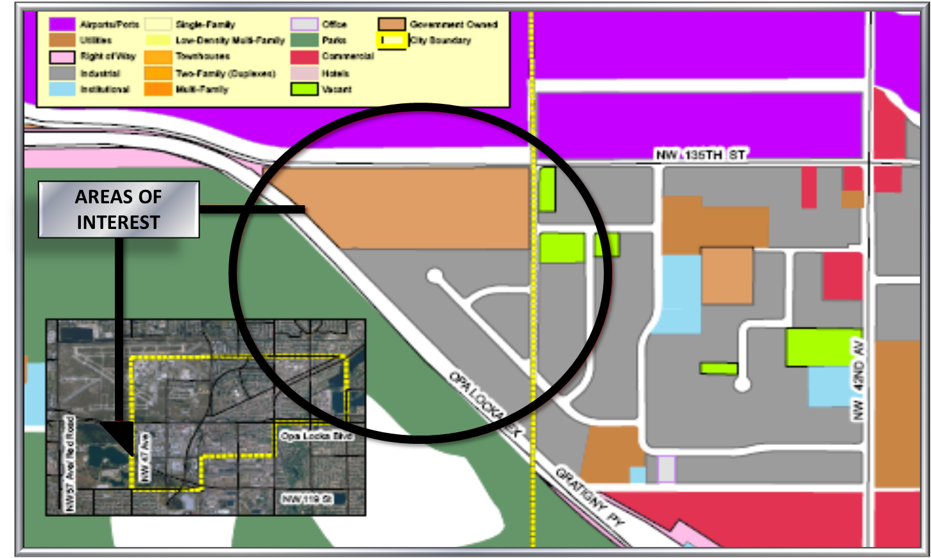
OPA-LOCKA STUDY AREA
NW 135 Street to Gratigny PKY & NW 47th Ave
Notes:
Close up of: Part A - covering NW 135th St to Gratigny and NW 47th Ave

Slide 4
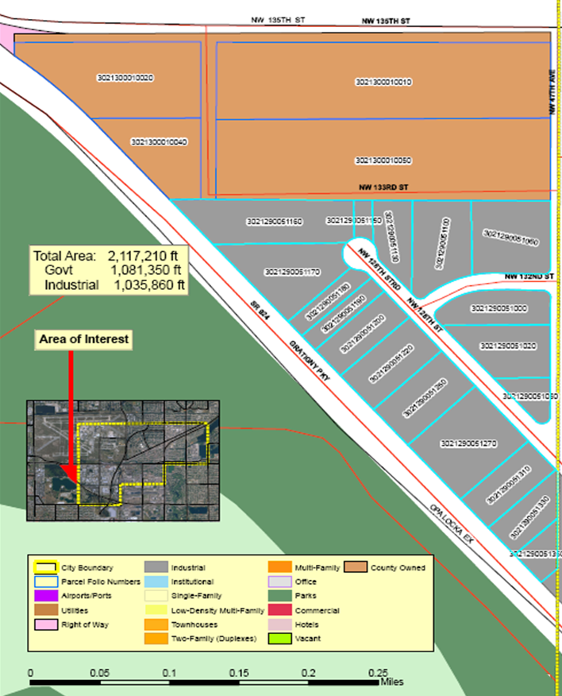
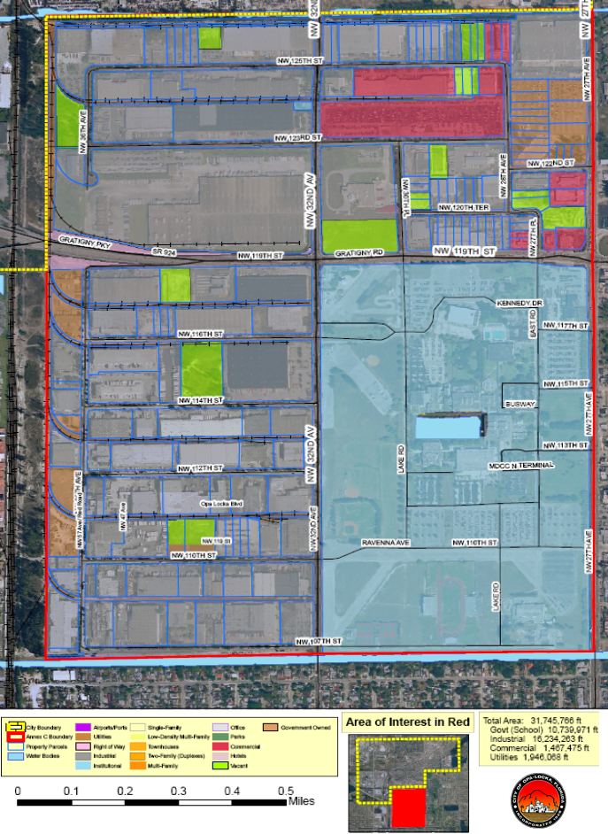
OPA-LOCKA STUDY AREAS
NW 135 St to Gratigny PKY & NW 47th Ave – 53 acres
NW 127 to 107 St and NW 37 to 27 Ave – 822 acres
Notes:
Detailed maps of both areas- A & B
Part A - covering NW 135th St to Gratigny and NW 47th Ave
Part B - covering NW 127th St to NW 107th St and NW 37th Ave to NW 27th Ave (Map 1)

Slide 5
REASONS FOR ANNEXATION
Expand City Boundaries
Acquire Industrial & Commercial Property
Increase Tax Revenues
Additional Ad Valorem Tax
Property
Tangible personal property
Occupational tax
Franchise Fees
Notes:
Review new reasons for annexation code enforcement and fines may not be politically correct.

Slide 6
CURRENT CONDITIONS: POPULATION

Slide 7
PROS OF CHOOSING PARTS A & B
Does not affect another municipality
No consent needed
Parks
No impact on Miami-Dade parks
No residents to affect City Level of Service
Waives requirement for resident voter approval

Slide 8
PROS OF CHOOSING PARTS A & B (cont.)
Greater Access to Government
Citizens do not have to travel downtown to the County Commission
No waiting all day for issues to be heard on a County Commission Agenda
Better chance for issues to be heard and recognized

Slide 9
CITY PROVISION OF POLICE SERVICES TO
AREAS A & B
Greater public safety by adding a total of 4.5 additional police officers for the annexation areas.
The estimated cost is $257,000 for both areas.
(Based on Officer salary and benefit costs per new officer FY 12-13)

Slide 10
CURRENT CONDITIONS: LAND USE

Slide 11
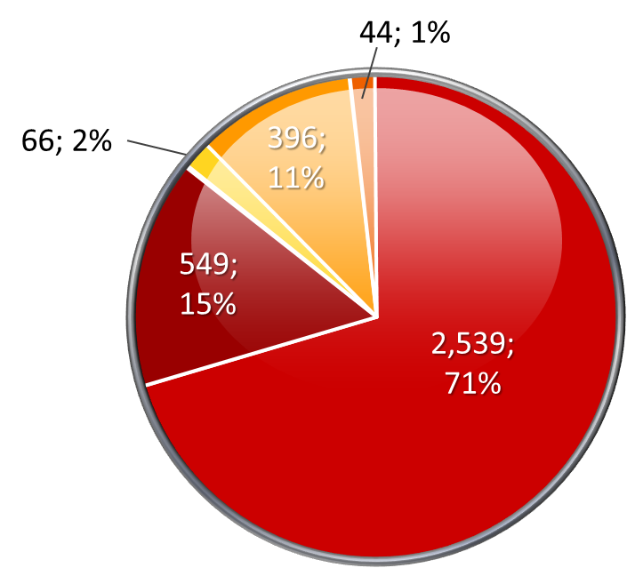
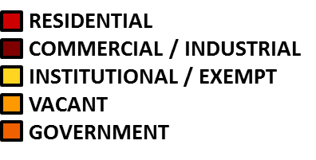
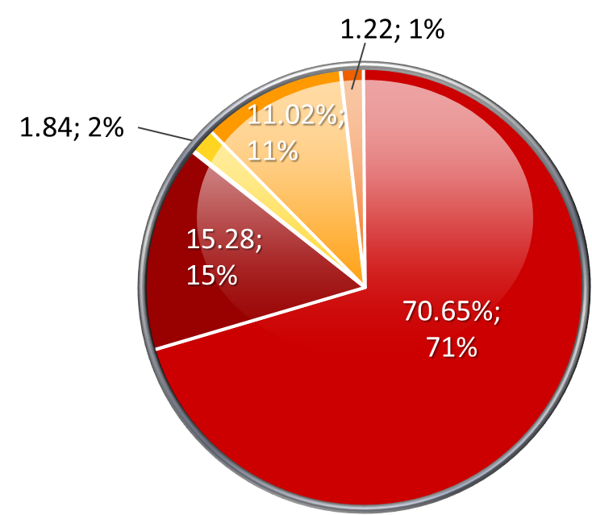
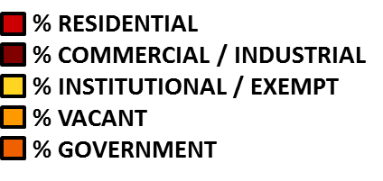
CITY PROPERTY ANALYSIS
Source: Miami Dade County Property Appraiser Date: October 11, 2011 Prepared by Gerald Lee

Slide 12
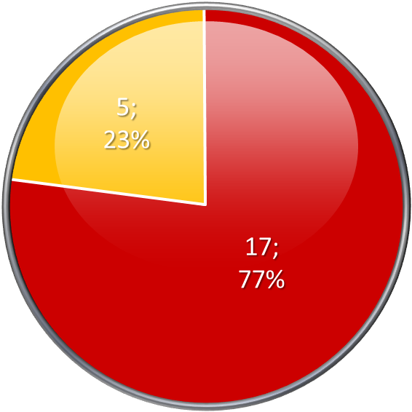

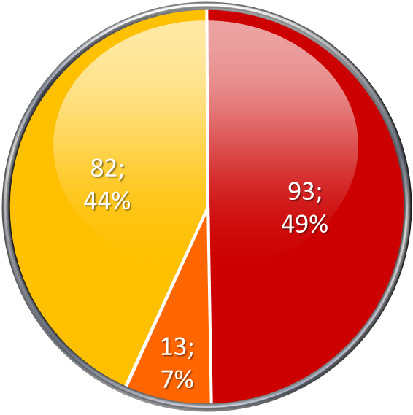
ANALYSIS OF ANNEXATION AREAS

Slide 13
CHANGES FOR THE CITY

Slide 14
PROPERTY TAX REVENUE ANNEXATION AREA “A”
The City of Opa Locka maintains a millage rate of 9.1000. The current Miami-Dade County millage rate is 1.9283.
Property Tax Revenue is determined by the following formula:
Revenue = Taxable Property X Millage X .95/1000
* Based on City of Opa Locka millage – Approximate
* * Public Works and Utilities - $70,000
Police - $26,000
Code Enforcement - $22,500
SECTION TOWNSHIP RANGE | 2013 TAXABLE PROPERTY ROLLS | PROPERTY TAX REVENUE* | COST OF PROVIDING SERVICES | NET BUDGET GAIN/LOSS
29/30-52-41 | $19,004,338 | $164,292 | $118,500** | $45,792

Slide 15
PROPERTY TAX REVENUE ANNEXATION AREA “B”
The City of Opa-Locka maintains a millage rate of 9.1000. The current Miami-Dade County millage rate is 1.9283.
Property Tax Revenue is determined by the following formula:
Revenue = Taxable Property X Millage X .95/1000
* Based on City of Opa-Locka millage - Approximate
* * Public Works and Utilities - $395,000
Police - $231,000
Code Enforcement - $95,000
NOTE: A number of properties with the Annexation Area are either owned by a governmental entity or by a railroad (CSX or Seaboard). The assessed value of all properties is $374,626,380. The value of the exempt properties totals $70,150,051 therefore the taxable property value for the Annexation Area is revenue for the $304,476,329 and the revenue will be based on that figure.
SECTION TOWNSHIP RANGE | 2013 TAXABLE PROPERTY ROLLS | PROPERTY TAX REVENUE* | COST OF PROVIDING SERVICES | NET BUDGET GAIN/LOSS
28/33-52-41 | $304,476,329 | $2,632,197 | $721,000** | $1,911,197

Slide 16

For Additional Information
Howard W. Brown, Jr., AICP
780 Fisherman Street, 4th Floor
Opa-locka, FL 33054
786-338-6177 (V)
hbrown@opalockafl.gov

